Slide 1


Docker
Docker Network

Slide 2
Lesson Agenda
To understand the basic networking concepts in Docker

Slide 3
Introduction
Docker networking is based on an open-source pluggable architecture called the Container Network Model (CNM).
libnetwork is Docker’s real-world implementation of the CNM, and it provides all of Docker’s core networking capabilities. it provides a native service discovery and basic container load balancing solution.
Drivers plug in to libnetwork to provide specific network topologies.
Docker ships with a set of native drivers that deal with the most common networking requirements. These include single-host bridge networks, multi-host overlays, and options for plugging into existing VLANs.
Ecosystem partners can extend things further by providing their own drivers.

Slide 4
Networking basics
Docker networking comprises three major components:
The Container Network Model (CNM)
Libnetwork
Drivers
The CNM is the design specification. It outlines the fundamental building blocks of a Docker network.
libnetwork is a real-world implementation of the CNM, and is used by Docker. It’s written in Go, and implements the core components outlined in the CNM.
Drivers extend the model by implementing specific network topologies such as VXLAN overlay networks.

Slide 5
The Container Network Model (CNM)
CNM defines three major building blocks:
Sandboxes
Endpoints
Networks
A sandbox is an isolated network stack. It includes; Ethernet interfaces, ports, routing tables, and DNS config.
Endpoints are virtual network interfaces (E.g. veth). Like normal network interfaces, they’re responsible for making connections. In the case of the CNM, it’s the job of the endpoint to connect a sandbox to a network.
endpoints behave like regular network adapters, meaning they can only be connected to a single network. Therefore, if a container needs connecting to multiple networks, it will need multiple endpoints
Networks are a software implementation of an switch. As such, they group together and isolate a collection of endpoints that need to communicate.
The atomic unit of scheduling in a Docker environment is the container.

Slide 6
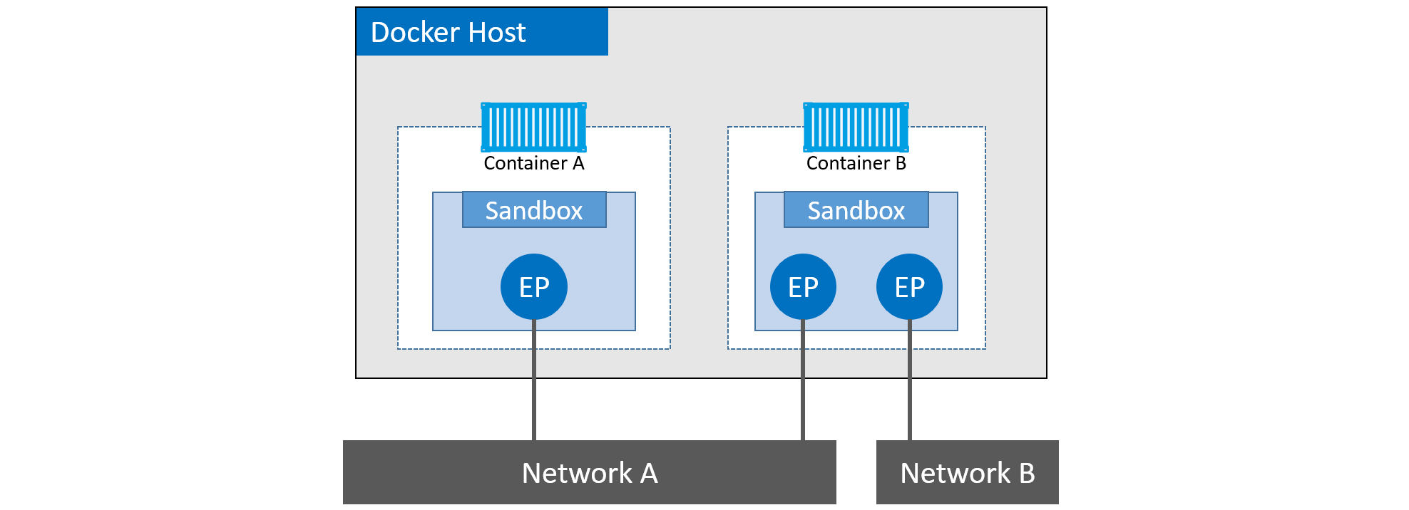
Container A has a single interface (endpoint) and is connected to Network A. Container B has two interfaces (endpoints) and is connected to Network A and Network B. The two containers will be able to communicate because they are both connected to Network A. However, the two endpoints in Container B cannot communicate with each other without the assistance of a layer 3 router.
Although Container A and Container B are running on the same host, their network stacks are completely isolated at the OS-level via the sandboxes.

Slide 7
Libnetwork
It is open-source, written in Go, cross-platform (Linux and Windows), and used by Docker.
it implements all three of the components defined in the CNM. It also implements native service discovery, ingress-based container load balancing, and the network control plane and management plane functionality.
control plane --> The control plane is the part of a network that controls how data packets are forwarded — meaning how data is sent from one place to another.
Management plane --> the management plane of a networking device is the element of a system that configures, monitors, and provides management, monitoring and configuration services to, all layers of the network stack and other parts of the system.

Slide 8
Drivers
drivers implement the data plane.
Data plane --> The data plane is the part of the software that processes the data requests
The control plane is the part of a network that controls how data is forwarded, while the data plane is the actual forwarding process.
Docker ships with several built-in drivers, known as native drivers or local drivers. On Linux they include; bridge, overlay, and macvlan. On Windows they include; nat, overlay, transparent, and l2bridge.
3rd-parties can also write Docker network drivers known as remote drivers or plugins.
Each driver is in charge of the actual creation and management of all resources on the networks it is responsible for.
In order to meet the demands of complex highly-fluid environments, libnetwork allows multiple network drivers to be active at the same time. This means your Docker environment can sport a wide range of heterogeneous networks.

Slide 9
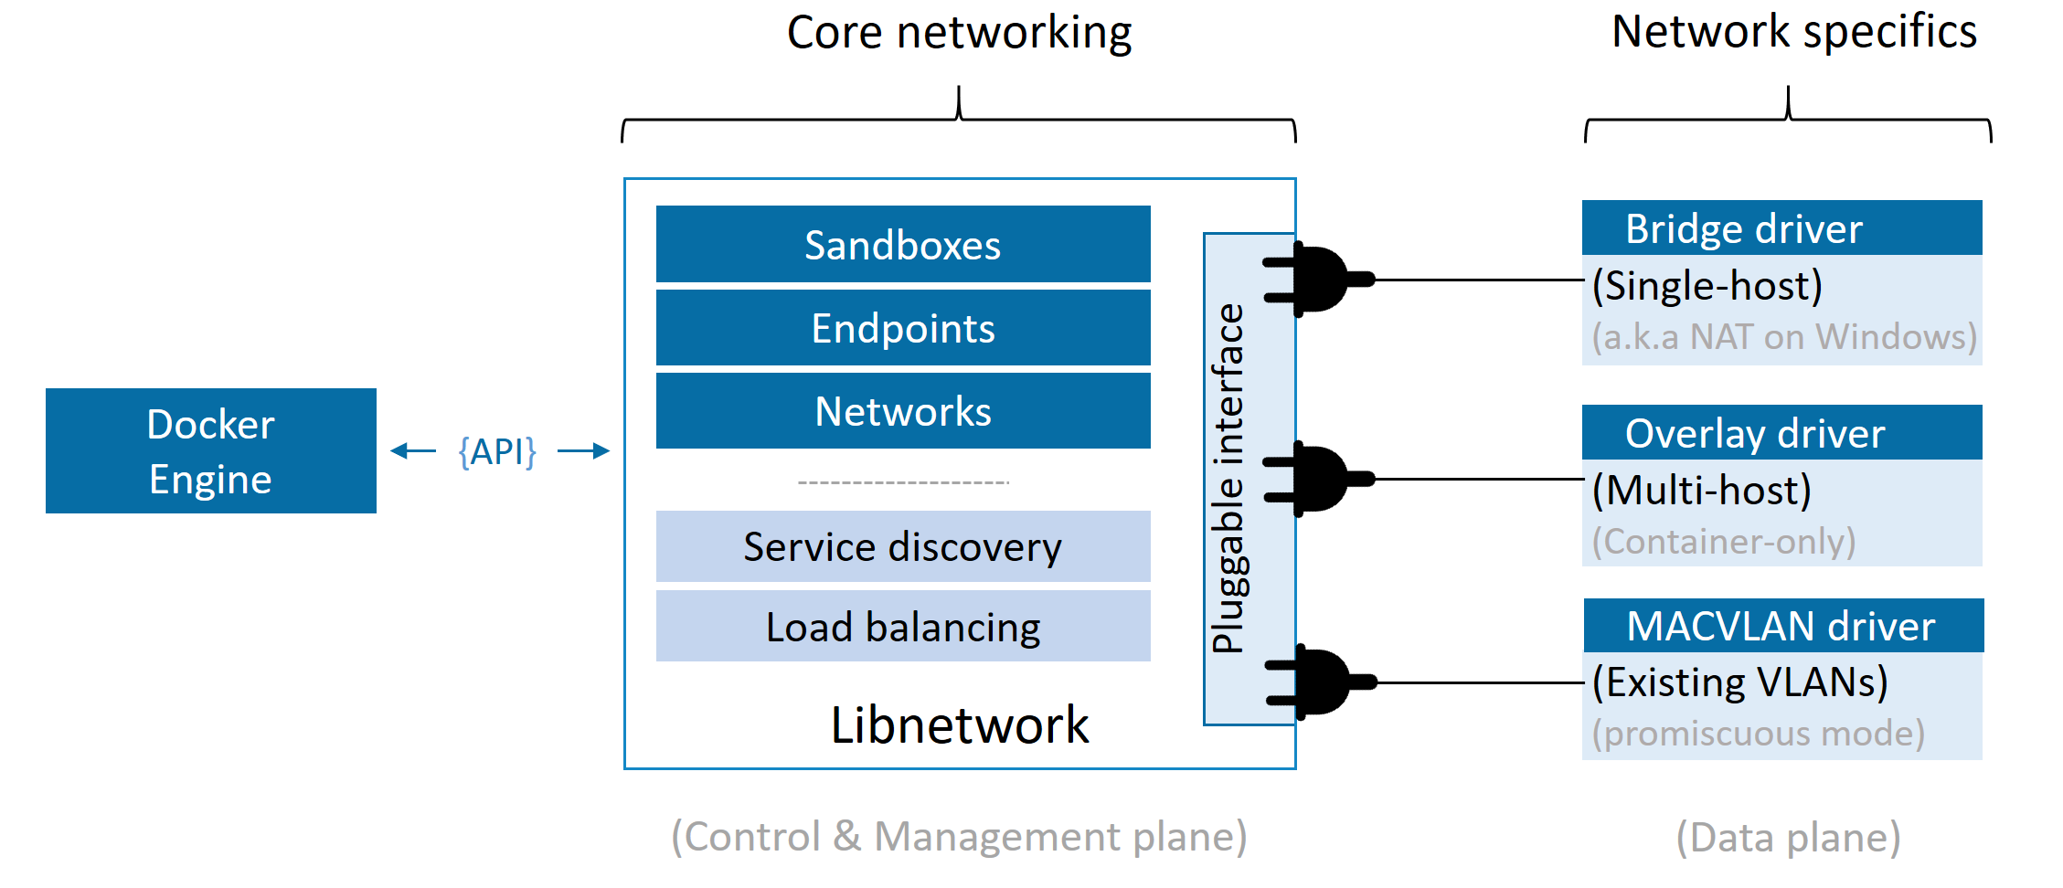

Slide 10
Single-host bridge networks
The simplest type of Docker network is the single-host bridge network.
Single-host tells us it only exists on a single Docker host and can only connect containers that are on the same host.
Bridge tells us that it’s an implementation of an 802.1d bridge
Docker on Linux creates single-host bridge networks with the built-in bridge driver, whereas Docker on Windows creates them using the built-in nat driver. For all intents and purposes, they work the same.

Slide 11
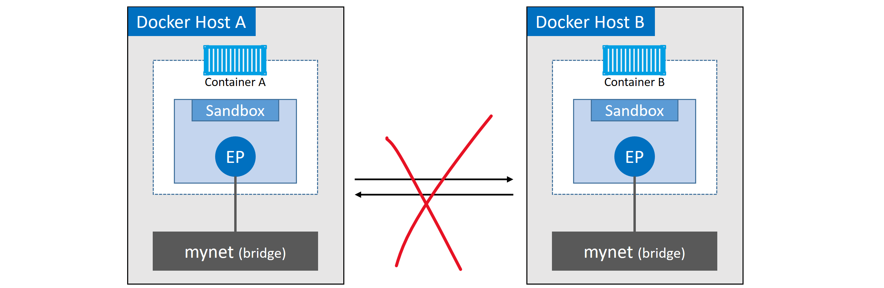
The two Docker hosts have identical local bridge networks called “mynet”. Even though the networks are identical, they are independent isolated networks. This means the containers in the picture cannot communicate directly because they are on different networks.

Slide 12
Every Docker host gets a default single-host bridge network. On Linux it’s called “bridge”, and on Windows it’s called “nat” (same names as the drivers used to create them). By default, this is the network that all new containers will be connected to unless you override it on the command line with the --network flag.
docker network ls
Notice the name and driver columns.
Docker networks built with the bridge driver on Linux hosts are based on linux bridge technology. This means they’re high performance and extremely stable. It also means you can inspect them using standard Linux utilities.
The default “bridge” network, on all Linux-based Docker hosts, maps to an underlying Linux bridge in the kernel called “docker0”

Slide 13
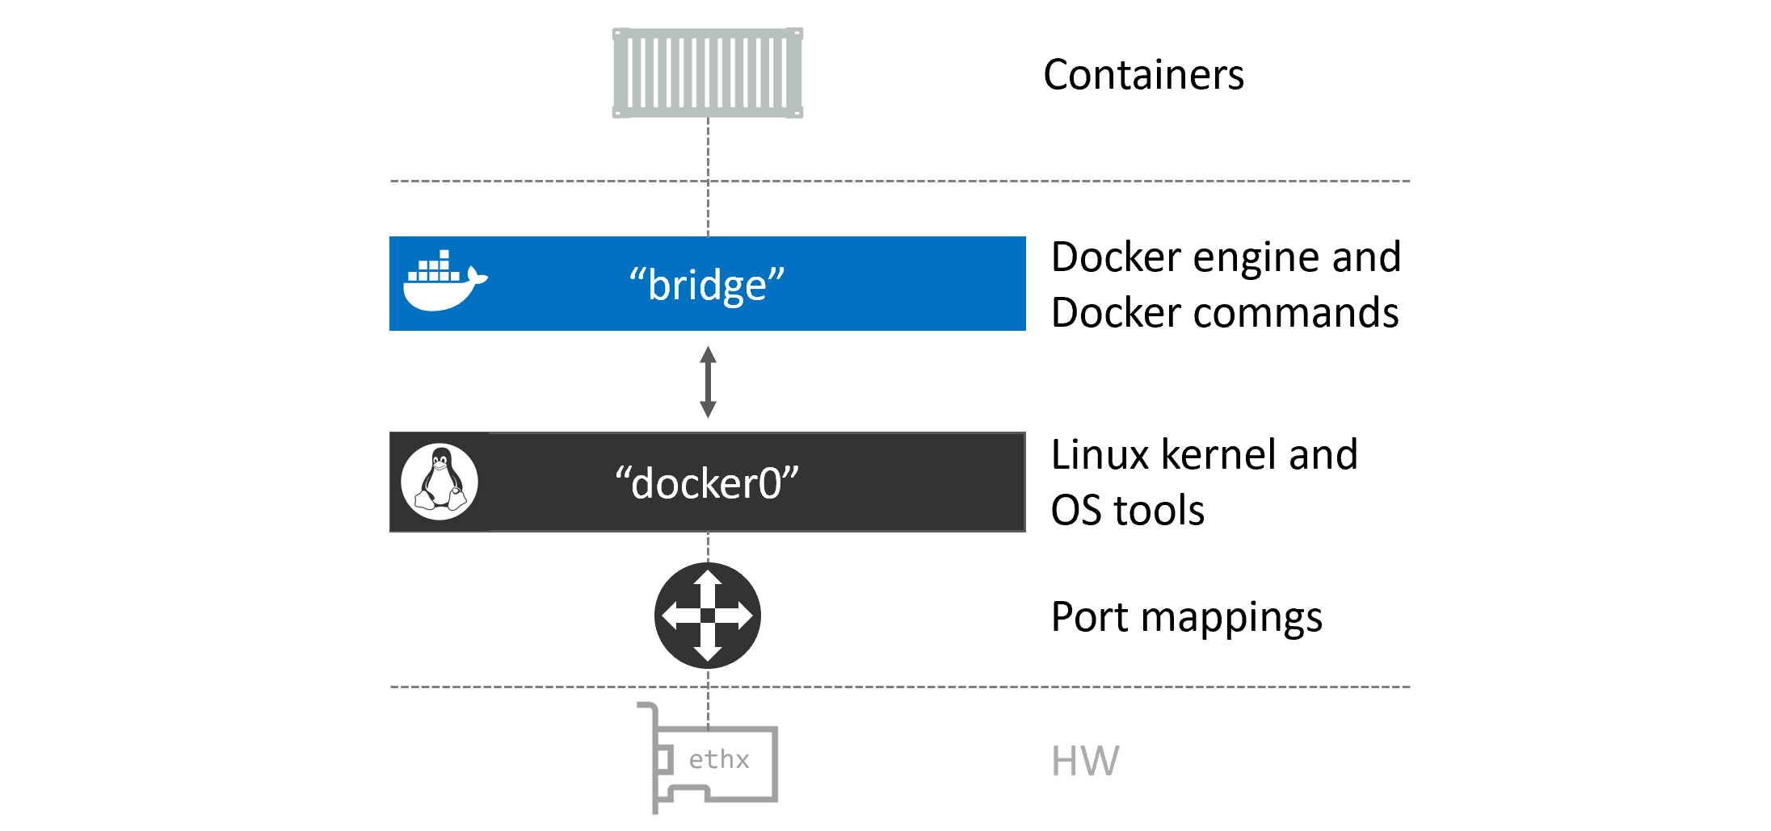
The “bridge” network maps to the “docker0” Linux bridge in the host’s kernel, which can be mapped back to an Ethernet interface on the host via port mappings

Slide 14
Demonstration
We shall now configure a network
There is some more theory for this lesson which requires a practical approach. You will find notes for that in the activity doc.

